Slide 1

EXPLORATORY DATA ANALYSIS on AMCAT

Slide 2
ABOUT ME
Bogaram Akshay Kumar (BBA)
Enthusiasitic and passionate towards Data Science
Data Science Intern
LinkedIn: www.linkedin.com/in/b-akshay-kumar
GitHub: https://github.com/akshay-kumar-bogaram

Slide 3
AGENDA
The dataset was released by Aspiring Minds from the Aspiring Mind Employment Outcome 2015 (AMEO). The study is primarily limited only to students with engineering disciplines. This project is about understanding the factors that are directly or indirectly related to Package for Graduates and Post Graduates. In this project we have done a thorough analysis, visualization and uncovered hidden insights
Exploratory Data Analysis:
Data Processing : Data Cleaning, Manipulation
Univariate Analysis: Analysed single columns individually
Bivariate Analysis: Analysed two columns to check relation
Multi variate Analysis: Analysed more than two columns to uncover the hidden insights in the data

Slide 4
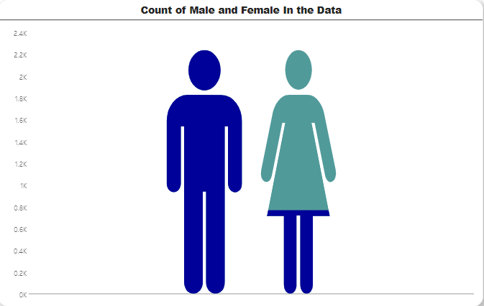
Distribution of Male and Female
OBSERVATION
In this data the distribution of Males is higher in number than female. The data distribution is imbalance.
76.06% Males and 23.94% Female

Slide 5
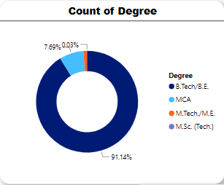
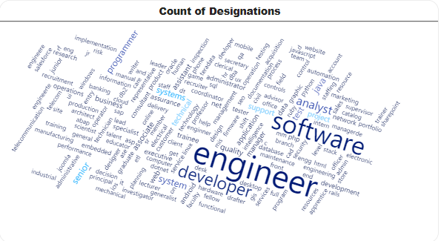
Count of Degree and Specializations
OBSERVATION
91% of employees are actually graduates (B.Tech/B.E), only 7.69% hold MCA, only 0.03% hold M.tech/M.E and rest have M.Sc.Tech Pg degrees

Slide 6
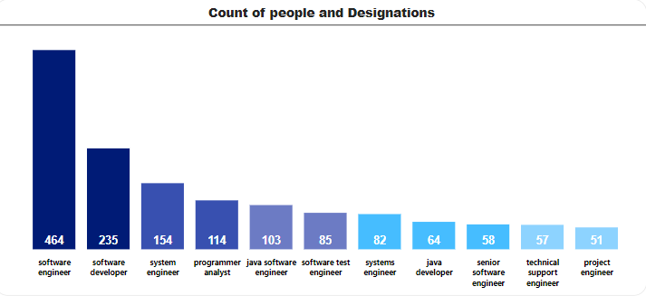
Most Common Job Among the Graduates
OBSERVATIONS
Most desirable job is software engineer, followed by software developer.
As per this data Operations Analyst has less number of people working.

Slide 7
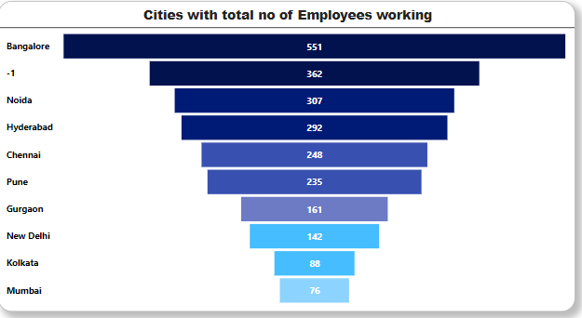
Cities which has Most No of Working Employees
OBSERVATION
As per the Data, Bangalore has most of working employees. Because Bangalore is main iT hub so it has more startup companies.
Greater Noida has 362 Employees, followed by Hyderabad and Chennai.

Slide 8
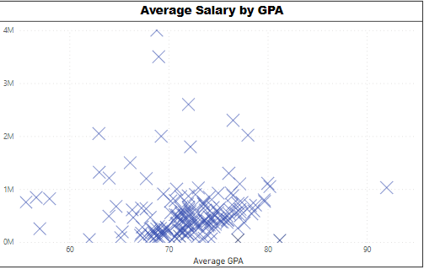
Salary based on GPA
OBSERVATION
Average percentage of students is 71%, mostly people who got 65 – 80 got a pretty decent package, but there are some outliers in the data who got GPA in between 65 – 80 still got highest package.
There might be some reasons: Top Graduation college, Specialization, importantly the performance in he Interview rounds

Slide 9
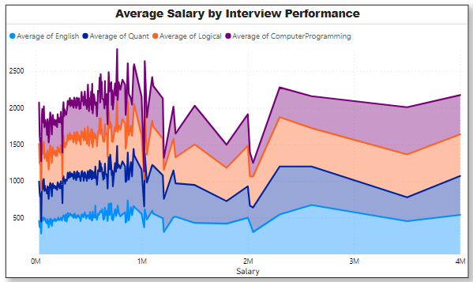
Analysis On Interview Round Subjects
OBSERVATION
People who performed well got the average salary100k , but who performed below average has base salary of 10k
There are people who got 550 and got the best package.
The salary data could be present earning data.

Slide 10
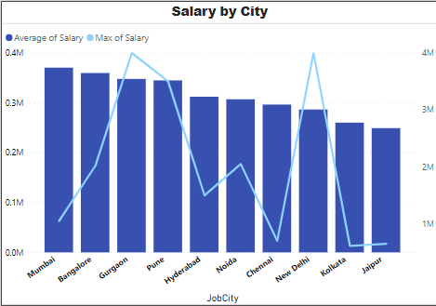
Cities differing in salaries
OBSERVATION
Average salary in Mumbai is higher than rest of the cities which makes sense, because Mumbai is costly city. Based on geographic location House rental allowances are fixed.

Slide 11
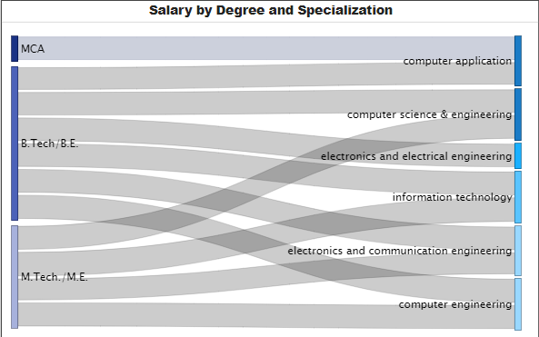
Degree & Specialization differing Salary
OBSERVATION
The Average income of BTech graduates is 300k.
The average income of MTech Post graduates is 370k
The average income of MSC Post graduates is 320k
Least earned are MCA Post graduates 260k

Slide 12
KEY OBSERVATIONS FROM THE ANALYSIS
From the analysis we have understood that College Tier, College Pass Out Year, are having no positive relation on the salary.
Recent Graduates from top-tier colleges are tend to have lower average salaries.
The gender distribution is imbalance, with 76% male and 24% female, there are gender disparities in the data.
Designations are diverse, majority falls under software engineer and software developer, from this we can say software related roles are highly preferred.
The majority of the students are working in Bangalore, Hyderabad, Pune, Gurgaon, Mumbai, Noida, the costlier the city the higher the salary the student can get. Students working in Mumbai have higher salaries.
The average GPA is around 70%, even though some students got 80-90 GPA, it is not related to higher salaries.
The main impact on salary is Interview round, students who performed well in English, Logical reasoning, computer programming, and importantly Quantitative Aptitude.
Quantitative Aptitude has higher relation on salary, students who performed well in Quant and performed average in other interview subjects have higher salaries.

Slide 13

THANK YOU

